Slide 1




NEXT GEN EMPLOYABILITY PROGRAM
Creating a future-ready workforce
Team Members
College Name
Student Name :A.K.Rajam Thanga Tamil
Student ID : au960221104088
Arunachala College of Engineering for Women

Slide 2

CAPSTONE PROJECT SHOWCASE
Project Title
Car Rentals Application with Django Framework
Abstract | Problem Statement | Project Overview | Proposed Solution | Technology Used | Modelling & Results | Conclusion

Slide 3
Abstract
Our Aim is to design and create a data management system of car rental company.
This enable admin can rent a vehicle that can be used by a customer
It acts as a interface between user and database.
By this system admin can mange customer confirm, Testimonials and issues
The system helpful to customer and admins who have access to powerful tools and generating reports to optimize business operations.
Source :

Slide 4
Problem Statement
In Existing system user or customer will directly interact with the car owner and owner will decide whether the car is available or not.
Then if it is available he will give rent cars to the customers.
The main drawback is customer need to meet the car owner so it is time waste process.
User should directly meet the owner and book the car so there will be no customer requirements.
Source :

Slide 5
Project Overview
In this car rental system we are going to introduce a online booking of car renting scheme will be available
Our aim is to design and create database management system for a car rental company.
We are using the user interface HTML and CSS so it is user friendly for the customers.
The admin will decide the requesting booking of the customer and decide to rent the car or not.
Source :

Slide 6
Proposed Solution
In car rental system user can directly interact through our system or application.
User book a car through online so it will takes less time.
IT will helpful to the car rental person too.
No need to directly contact with the owner.
In this system we can provide access from remote locations.
The car rental system provide any brand of vehicle for rent and integrates frontend and backend technologies to provide efficient experience to the users.
Source :

Slide 7


Technology Used
Front-end
Back-end
Source :

Slide 8
Modelling & Results
In the near future we are planning to provide GPS tracking facility so the client can able to track the car location.
Planning to add new features like pay after the trip
We are working to increase automation in the system to increase user experience great.
The customer can use the vehicle as his own with the agreement
By this car rental system, the organization can increase the business and satisfy the customer needs.
Source :

Slide 9
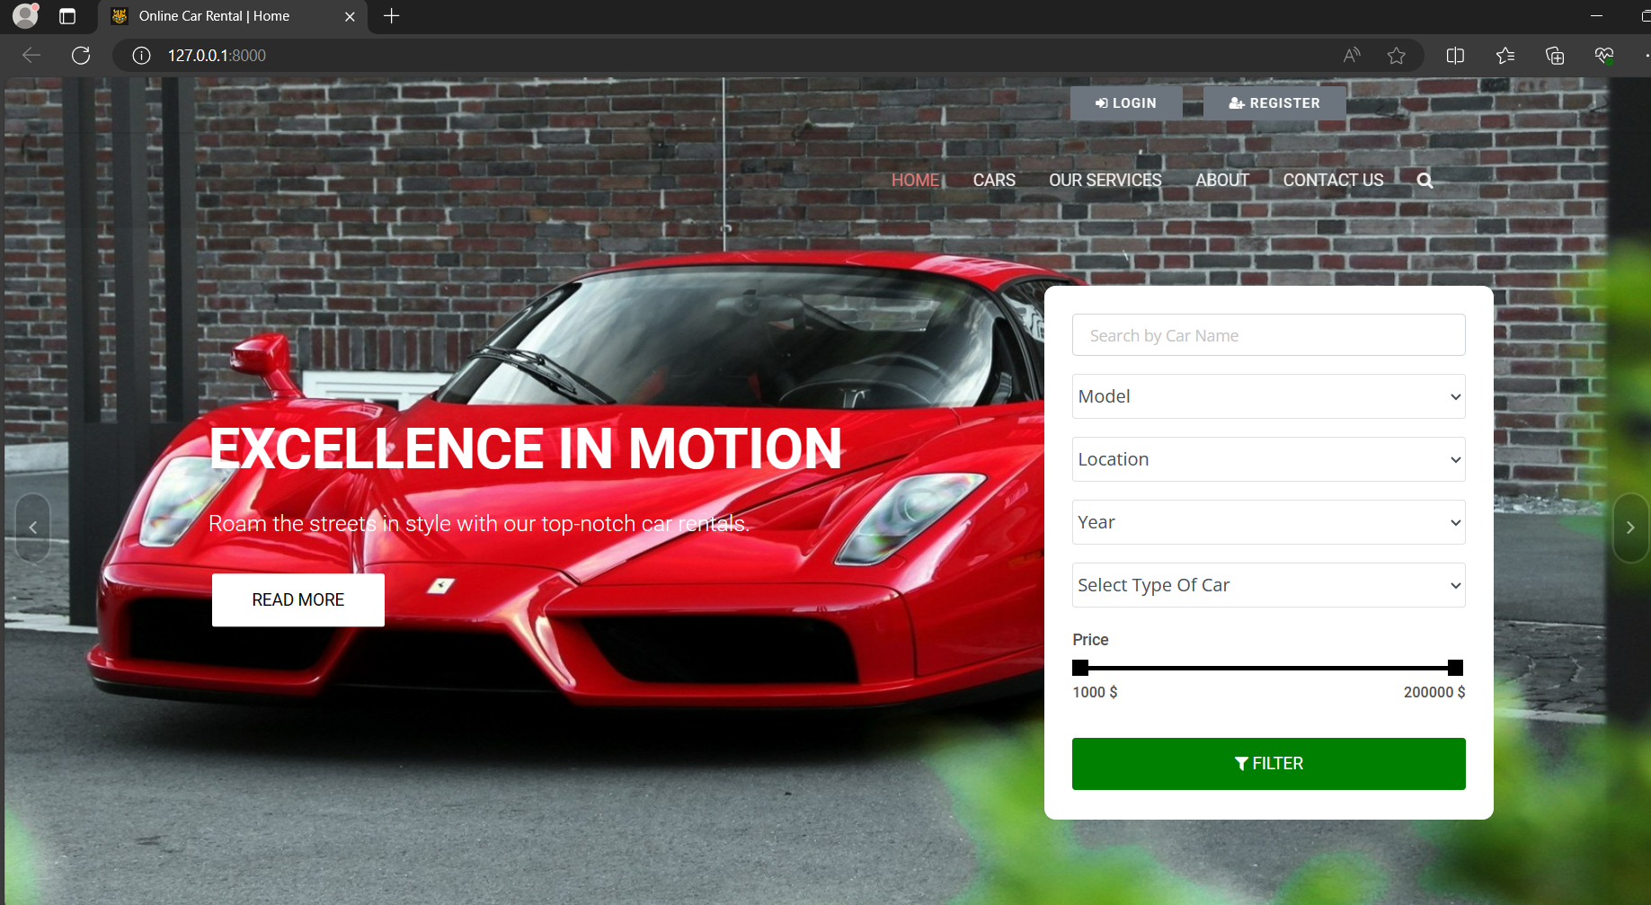
Homepage

Slide 10
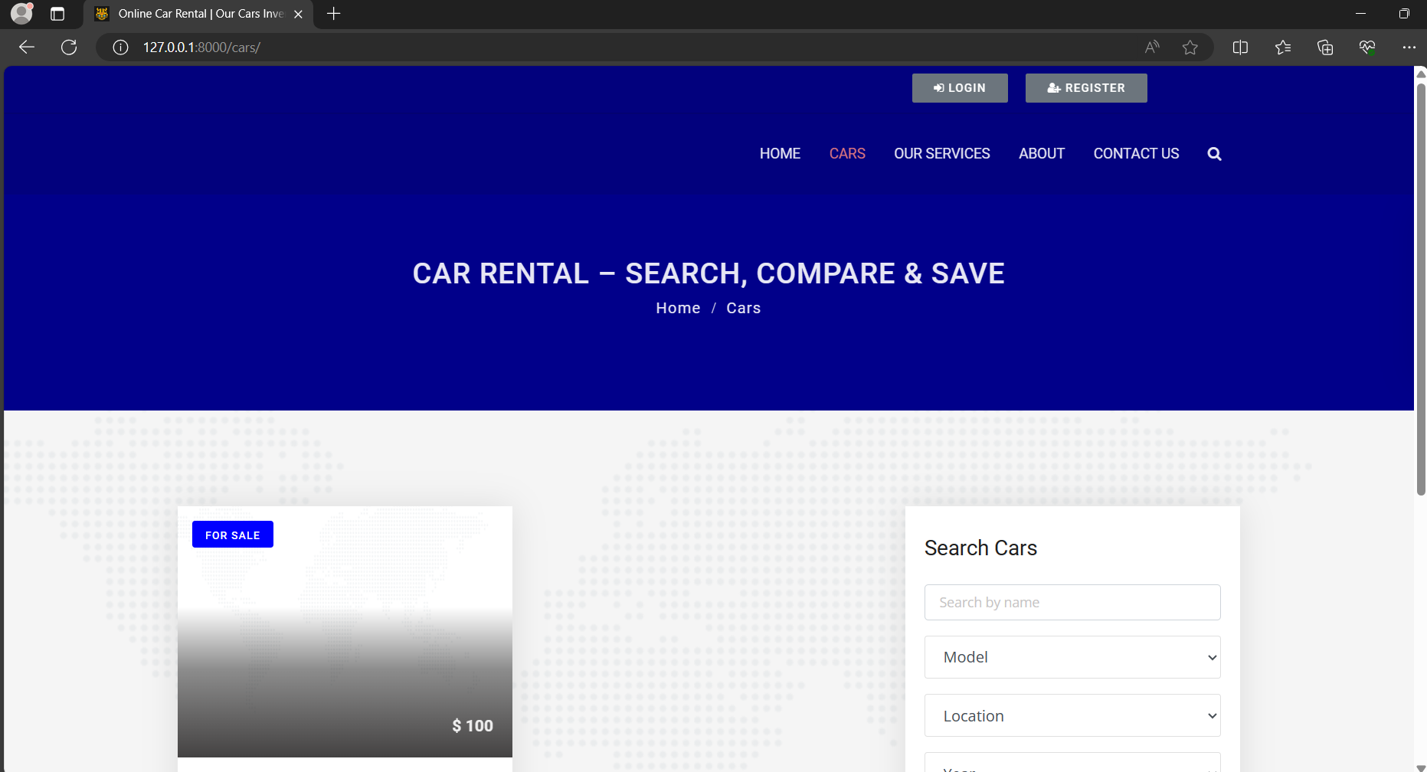
Cars-Page

Slide 11
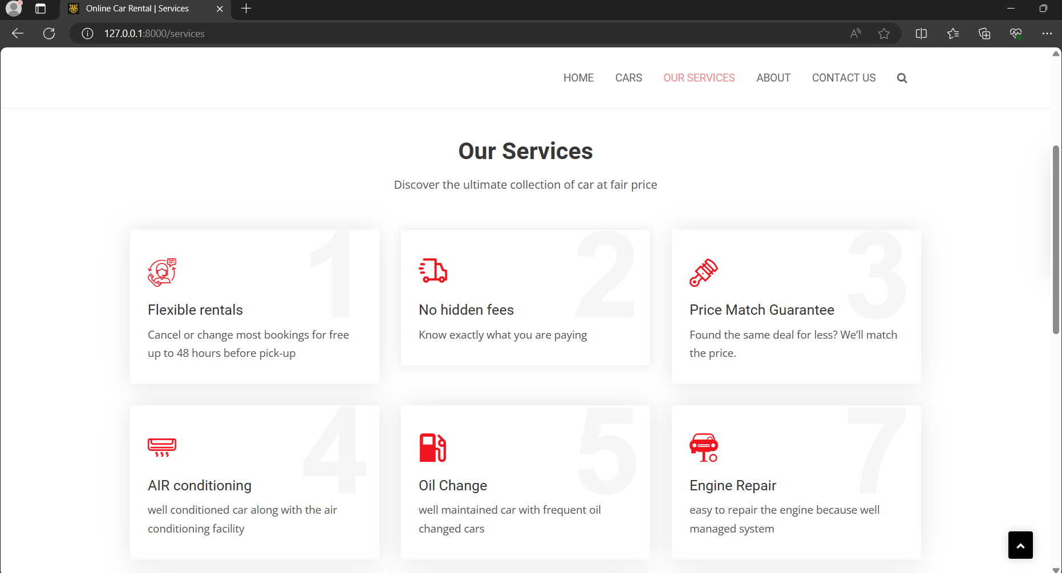
Our Service-Page

Slide 12
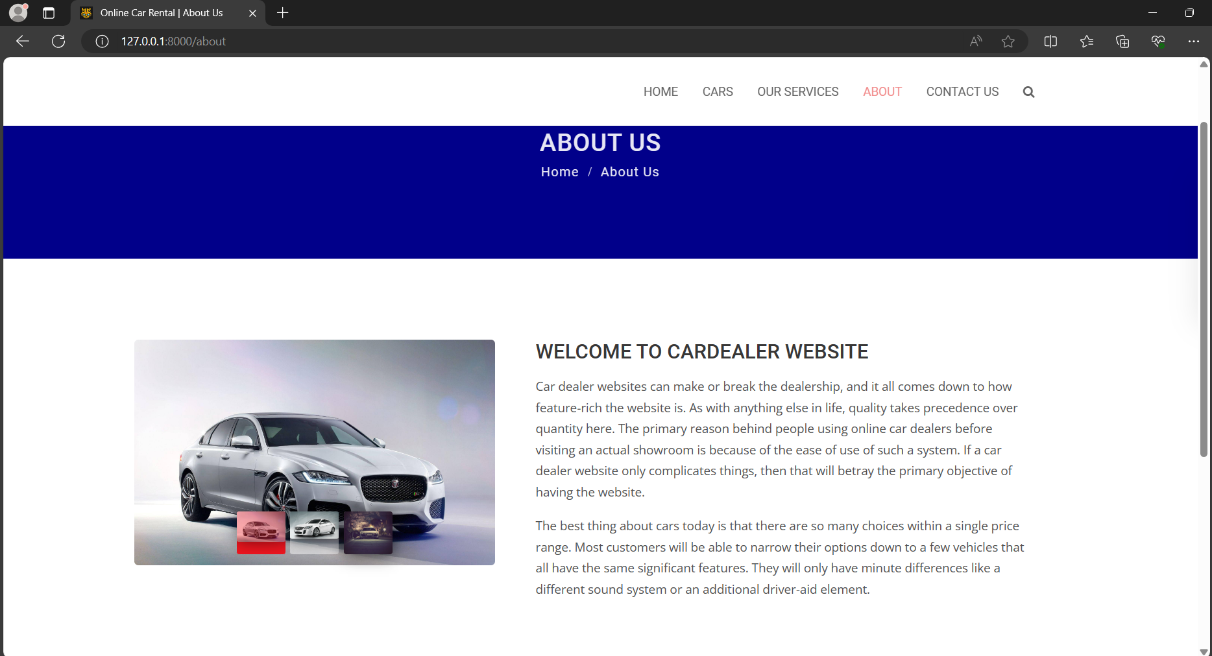
About-Page

Slide 13
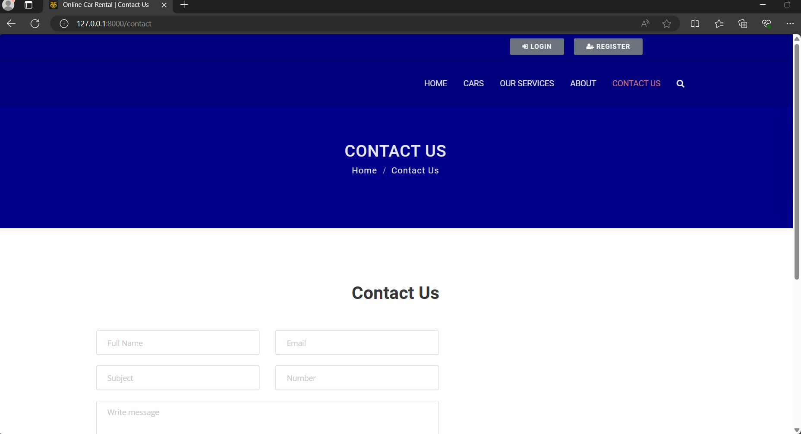
Contact us-Page

Slide 14
Future Enhancements:
In the near future we try to improve the application by adding more features to it and also it leads to integration of AI & ML,Mobile app development,expansion of services and so on.
Like GPS tracking, Low cost with higher customer satisification.
We will spend more time to satisfy the concern of all the customers.It has enhanced fleet management and IOT incorporation.

Slide 15
Conclusion
The Car rental application is very a useful application in the current environment and it presents a comprehensive solution for facilitating smooth vehicle rentals.
Its main advantage is,it provides the remote location access this the high needs of the today’s generation people
We are also provided with the friendly user interface.
It can be easily accessed by all the people.
Source :

Slide 16
Thank You!
Notes:
Thank You !!

